Slide 1
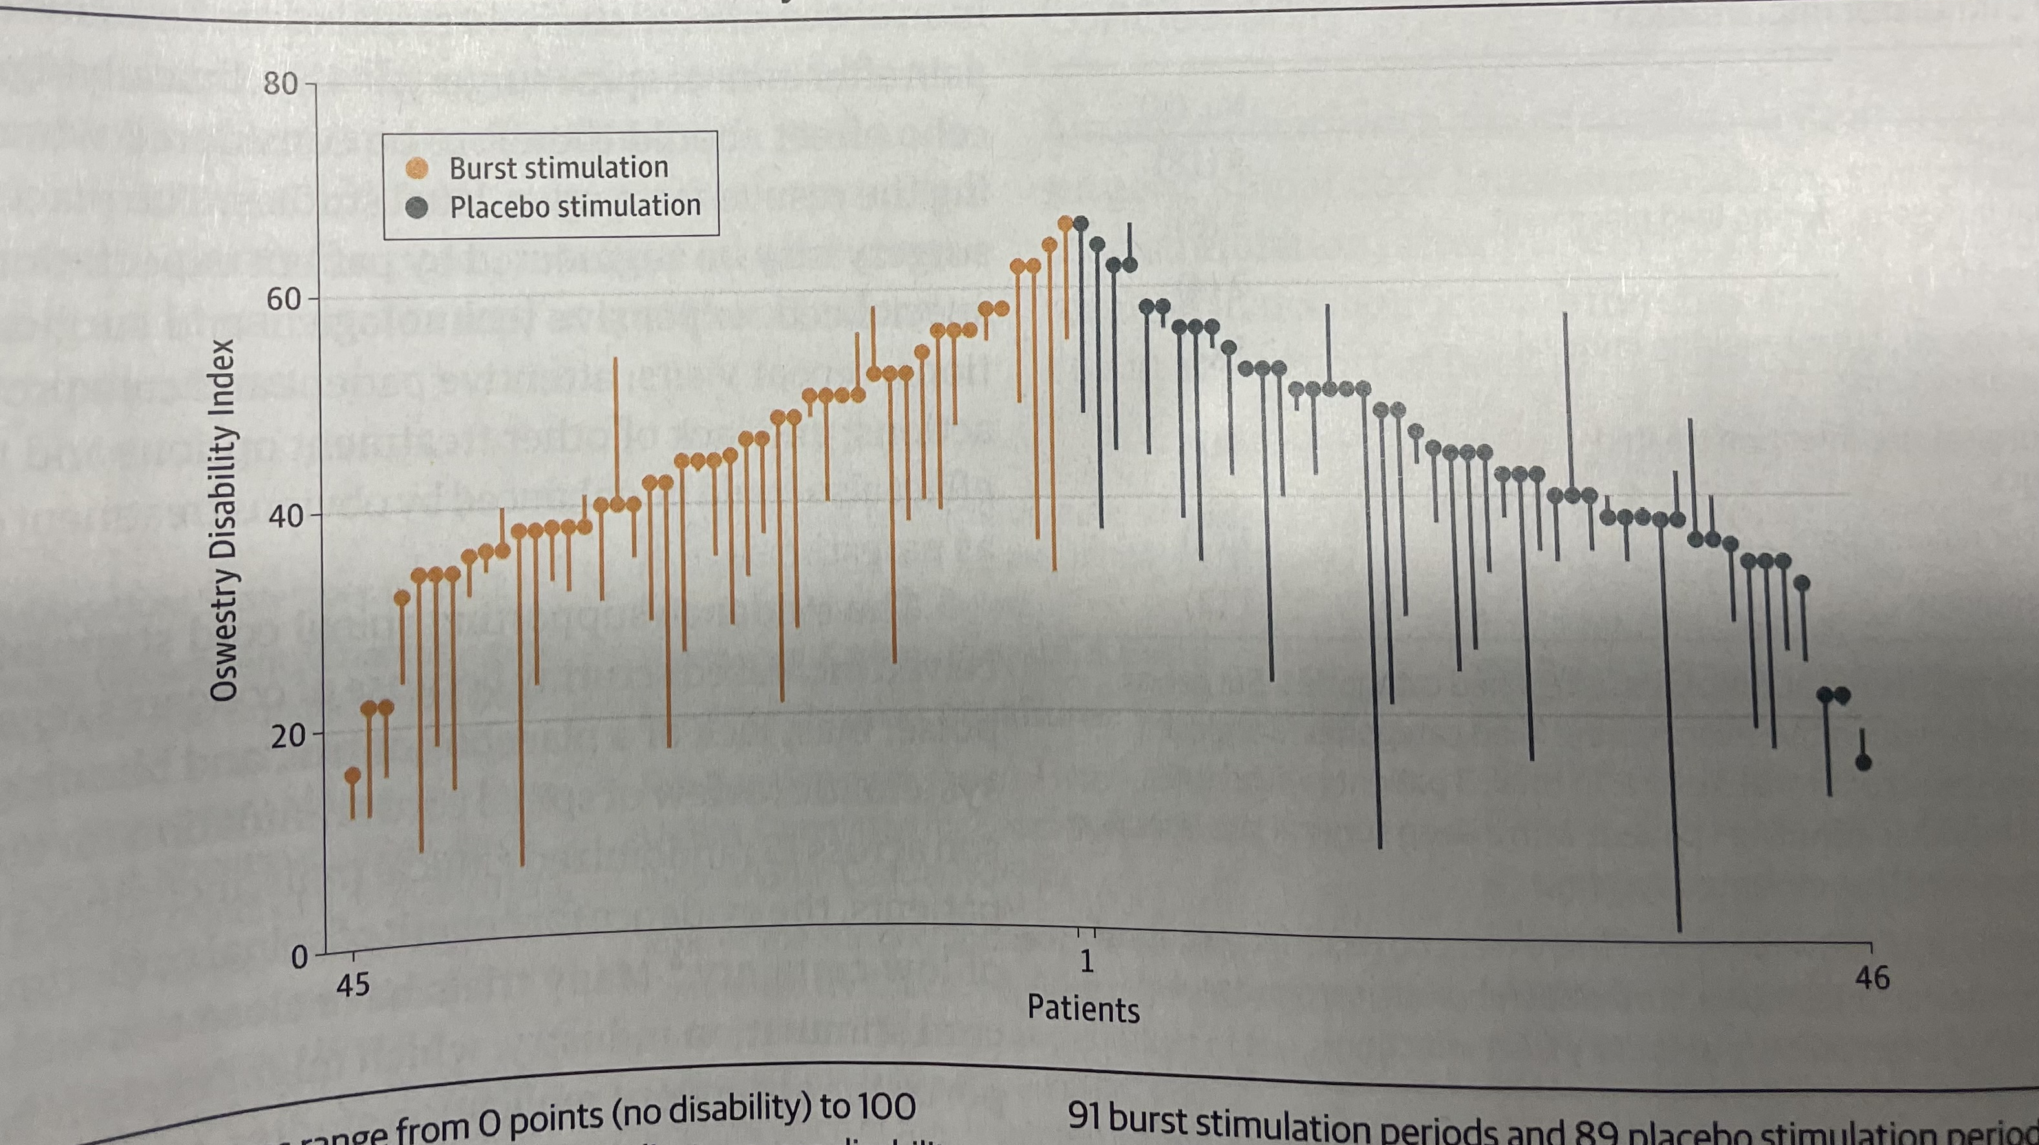
PGR
Brian Locke
Disclosures: I plan to stir the pot
Notes:
[ ] from the spinal stimulator JAMA rct – negative result. Find this. Oct 2022
The play of chance and what we think we know about diagnosing a lung disease.
Why do we have control groups?
What is regression to the mean?
Twiny sim?
Play of chance
“Diagnosticty and foundations of information theory / likelihoodism” - A-a gradient
“Play of Chance” and response to trial of ____
Asthma Diagnosis: The problem isn’t what we don’t know, it’s what we think we know that ain’t so!

Slide 2
Case: Otero [ ] maybe don’t give this all up front?
55M – presents with slowly progressive DOE, no particular triggers, not much day-day variation.
Used to Smoke, 1ppd x 30y. Quit 5 years ago
BMI 37
Felt better with ICS/LABA (empiric through PCP), feels albuterol helps
“COPD” diagnosis in the chart.
Untreated OSA
ABG: 7.39 / 46 / 65 on room air (A-a gradient normal) – uses O2 with exertion because it makes him feel better.
Mild restriction with +BD on Spiro

Slide 3
Study idea: could you model how well the reported sensitivity and specificity occur in TriNetX data? Do the ‘assumptions’ hold?

Slide 4
https://twitter.com/f2harrell/status/940595034121961472?lang=en
https://twitter.com/f2harrell/status/1085615414820958209

Slide 5
NYT article link in depression
https://www.nytimes.com/interactive/2022/09/27/opinion/how-to-treat-depression.html
Notes:
But with a counterfactual (split screen) where things get better on their own.
——-
Twiny simulations based on randomness?

Slide 6
What is the implied disease course?
Ex hoc ergo prompter hoc
Voltaire: ‘“The art of medicine consists in amusing the patient, while nature cures the disease”’
Notes:
Example of random steps forward and backwards from midfield = generates the normal distribution

Slide 7
Part 1: Empiric Trial of Inhalers as a method of diagnosing airways disease
Randomized Controlled Trial example
  [ ] Inhaler vs placebo? https://www.ncbi.nlm.nih.gov/pmc/articles/PMC3154208/
  A: The placebo effect of inhalers is large
  B: Regression to the mean
  C: Most asthma flairs are self-limited
  D: there is some random error associated with dyspnea assessments.
Notes:
“see also - More recently, in a study by Castro et al. in which patients were randomized to undergo active or sham bronchial thermoplasty, 64 % of sham-treated patients showed improvement in quality of life [24]”
Placebo effect in Asthma review: https://www.ncbi.nlm.nih.gov/pmc/articles/PMC4351653/
Citations of inhaler vs placebo studies: 13, 37, and 42-45

Slide 8
Regression to the mean
Summarized nicely here by Senn: http://www.cambridgeblog.org/2022/12/the-mean-side-of-the-force-how-regression-to-the-mean-can-fool-us/

Slide 9
Self-limited disease
Azithromycin vs Placebo in Viral infections

Slide 10
The natural history:
The more variability in symptoms, the more regression to the mean
  The more imprecision in measurement, the more regression to the mean
    All the non-disease related factors that influence patients response to questionaires (hangry? Just want to be done? Etc.) are essentially random in this sense
The more predictably self-limited conditions are, the better pre-post comparisons will be

Slide 11
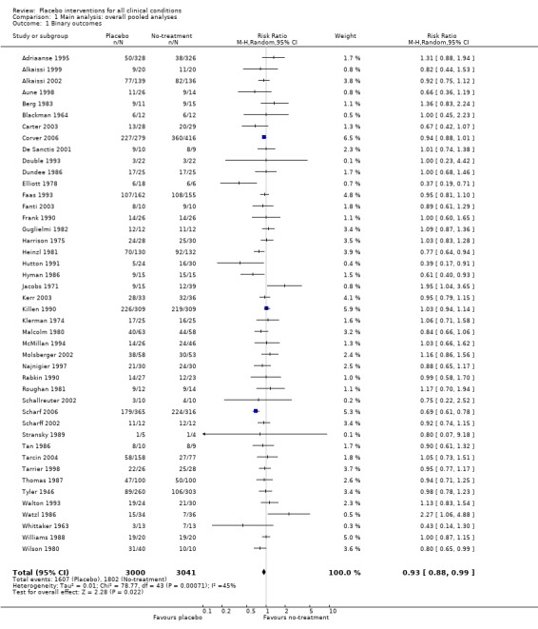
Confusion on this point is widespread
Pre-post comparison is not the placebo effect
https://www.ncbi.nlm.nih.gov/pmc/articles/PMC7156905/
Meta-analysis of 202 trials (60. conditions) including a placebo and a no-treatment arm.
“We did not find that placebo interventions have important clinical effects in general. However, in certain settings placebo interventions can influence patient‐reported outcomes, especially pain and nausea, though it is difficult to distinguish patient‐reported effects of placebo from biased reporting. ”
Notes:
WRONG
Standard Mean difference.
Binary outcomes: RR 0.93 (0.88-0.99)
Continuous outcome: SMD -0.26 for patient reported outcomes, SMD -0.13 for observer reported outcomes
No placebo for: smoking, dementia, depression, obesity, hypertension, insomnia and anxiety
Notable placebo in:
pain, SMD ‐0.28 (95% CI ‐0.36 to ‐0.19))
nausea, SMD ‐0.25 (‐0.46 to ‐0.04))
asthma (‐0.35 (‐0.70 to ‐0.01)). -→ todo: explore what, specifically, this was.
phobia (SMD ‐0.63 (95% CI ‐1.17 to ‐0.08))
Dyspnea and Inhalers are likely to elicit a large placebo response.
Meta‐regression analyses showed that larger effects of placebo interventions were associated with physical placebo interventions (e.g. sham acupuncture), patient‐involved outcomes (patient‐reported outcomes and observer‐reported outcomes involving patient cooperation), small trials, and trials with the explicit purpose of studying placebo. Larger effects of placebo were also found in trials that did not inform patients about the possible placebo intervention.
[ ] note inhelers for other diseases

Slide 12
Abductive Reasoning
”I gave the patient an inhaler and they felt better. Odd coincidence, unless they have asthma”
Formally: “reason backwards from an effect to a cause that explains it”
Can yield robust knowledge:
Example: General relatively predicted that light would be bent around an eclipse
Eddington led an expedition to a small island of the coast of Africa in 1919- 1.75 seconds of arc deflection of light from Hyades start cluster.
reasoning backward: it must be that general relativity is true.

Slide 13
The likelihood principle explains how strong evidence is
Formally:
  Likelihood of observing light bend if Relativity is true (HO): ~1
  Likelihood of observing light bend under classical physics (H1): ~0
Likelihood ratio: the amount of support an observation gives in support of HO over H1.
  Likelihood ratio(observing light bend) = HUGE

Slide 14
The likelihood principle
“Bayesianism and likelihoodism “both interpret experimental results by using the law of likelihood”. The law of likelihood states: data x support H1 over H0 if the likelihood of H1 exceeds H0, that is, if the likelihood ratio Pr(x|H1)/Pr(x|H0) exceeds 1. The likelihood function is the probability (or density) of the observed value of the test statistic, regarded as a function of the unknown parameter(s). The likelihood principle (LP), which goes a bit further, asserts that all the evidence about the unknown parameter(s) resides in the likelihood ratio, once the data are observed”
Notes:
Doesn’t involve pretest probabilities, etc. – for any of those that are uneasy about going full bayes.. This is an application of evidence regardless how you conceptualize statistics.

Slide 15
Is ICS/LABA or SABA good evidence for asthma?
Likelihood of improvement if they have asthma? ~0.9
Likelihood of improvement without asthma? ~..0.5?
  How variable are reports of dyspnea in general?
    REGRESSION TO THE MEAN
      Most people are starting medications on bad days: if they were having a good day, they’d say no to more meds.
  Are people with asthma symptoms credibly more susceptible to placebo then people without asthma?
    NOT REGRESSION TO THE MEAN
Likelihood of improvement in dyspnea in non-asthma conditions?
CHF trials? PAH trials? Morphine/palliative trials? (consider, dyspnea’s close relationship to panic)
LR – while this isn’t nothing, it certainly shouldn’t be the basis of a diagnosis.
*sidebar: if you make the jump of representing your uncertainty as odds, then multiplying by the LR is provably the most efficient use of data as its represented – this is why Bayes is famous.
Notes:
The fundamental insight is from De Finetti (Dicing with Death) = likelihoodism. The amount you should update your belief (or likelihood) depends on how much different the likelihood is to see in each case. The ratio of these likelihoods is the likelihood ratio.
If you apply the numbers, specifically odds, to summarize your pretest knowledge and multiplier by this likelihood ratio, you are left with a post test odds for how one should optimally use that information. This is the likelihood formulation of Bayes theorem, and the insight that works is why Baes is so famous. And, if you buy the assumptions of that model it is provable that is the most efficient way to use the information from the data.
With a small twist and reasoning, you can use abduction to work backwards from the data you see, to the diagnosis that’s most likely

Slide 16
We’re prone to confusion of this sort in many forms:
https://en.wikipedia.org/wiki/Cold_reading Cold reading - tie in severity?

Slide 17
https://link.springer.com/article/10.1007/s00024-022-03137-2
Humans are also bad at judging and creating randomness: we have apophenia and pareidolia, a tendency to see patterns in randomness
Notes:
A common taxonomy classifies uncertainties as aleatory or epistemic. Aleatory uncertainty results from the play of chance mechanisms—the luck of the draw. Epistemic uncertainty results from ignorance. Epistemic uncertainty is ‘stuff we don’t know’ but in principle could learn.

Slide 18
Some discussion of variability here: https://www.ncbi.nlm.nih.gov/pmc/articles/PMC8483219/
MCID of dyspnea rating scales or st George questionnaire?
  https://pubmed.ncbi.nlm.nih.gov/20843247/
  https://pubmed.ncbi.nlm.nih.gov/8625661/
  https://www.ncbi.nlm.nih.gov/pmc/articles/PMC6387992/

Slide 19
Could we do this better?
N of 1 trials? Relation to this?
Control charts with asthma

Slide 20
Things that have a variable course are more likely to have “home remedies” - you take them and you get better
  Vitamins for cold
  Prune juice for UTIs
The kicker is that you would have gotten better just as much before.

Slide 21
In sum,
We should generally be skeptical of diagnoses structured as “I started a treatment for X and it worked, therefore the patient has X”
  Especially in the cases where:
    Most people get better from X regardless
    There is a lot of variability in symptoms from X (regression to the mean)
    The rare case where there are important placebo effects
Bronchodilators for asthma fit all of these

Slide 22
Responder fallacy? [ ] read and think about this from Senn – he’s done work in Asthma so there may be more of this he’s written about
https://errorstatistics.com/2014/07/26/s-senn-responder-despondency-myths-of-personalized-medicine-guest-post/

Slide 23
Part 2: Spectrum Bias and the problem with PFTs
[ ] Review this Lancet Paper: “After asthma - redefining airways diseases. A Lancet commission” Corresponding Author: Professor Ian Pavord, DM FRCP
“Q: What are the problems with "trial of ICS" as a method of diagnosing asthma? A: result of the relative difficulty of pulmonary function tests in in the primary care setting and the absence of rule out tests has been that primary care clinicians feel they have few options other than a ‘trial of treatment’ approach with ICS. This approach is flawed because the mimics of asthma (which often do not respond to corticosteroids) cause variable symptoms and may therefore improve spontaneously over time, leading to the mistaken belief that ICS treatment has been beneficial”
[ ] 16 Brenner S, Güder G, Berliner D, Deubner N, Fröhlich K, Ertl G, et al. Airway obstruction in systolic heart failure—COPD or congestion? Int J Cardiol. 2013 Oct 3;168(3):1910–6.
  Why do we not do diagnostic PFTs inpatient? ***
Normal reference ranges compared to healthy individuals is a useful designation for determining whether a person is diseased or not diseased. However, it is not a useful designation for whether somebody who has symptoms has disease a or disease be, which requires different data
Notes:
HF worsening
obstruction; citation 12: Roversi S, Fabbri LM, Sin DD, Hawkins NM, Agustí A. Chronic obstructive pulmonary
disease and cardiac diseases. An urgent need for integrated care. Am J Respir Crit Care
Med 2016;194:1319–1336.
and wheezing citation 15: Renier W, Hoogma-Von Winckelmann K, Verbakel JY, Aertgeerts B, Buntinx F. Signs and symptoms in adult patients with acute dyspnea: a systematic review and metaanalysis. Eur J Emerg Med 2018;25:3–11.

Slide 24
PGR test limits
https://www.ahajournals.org/doi/10.1161/JAHA.121.023422 good cohort and also good references supporting the point that PFTs measure lung function but are of limited value differentiating heart vs lung disease

Slide 25
Part 3: How good is a normal A-a gradient anyway?
Does normal A-a gradient exclude significant V/Q mismatching? A critical look

Slide 26
Take-aways
The placebo effect is widely misunderstood. It is actually rarely clinically meaningful. It’s place in popular/medical culture is more a result of its memetic power than it’s truth
We see patterns in everything. Treatment response in a highly variable indicator is prone to over-interpretation

Slide 27
Summary
Why do pulmonary patients receive so many different diagnoses from so many providers?
I think it is partly because pulmonary diagnostic tests are not very good
  If the cumulative diagnosticity of your tests is not very high, then the pre-test likelihood of various disease states should guide comparatively more of your diagnosis
  A panopoly of empirical evidence suggests humans are very bad at interpreting “weak signals” (ie. weak tests)
  Some subfields of pulmonary medicine have come up with ways against us, for example the ILD multidisciplinary rounds idea. But, I don’t think this is formalized and other parts of pulm medicine.
  We should only put *the right amount of trust* in our diagnostic tests – which is certainly less trust than I thought before fellowship
Notes:
this PGR is inspired by a observation I had talking with one of my friends who is now an oncology attending here. He noted that one of his patients was referred to us and through the consult service ICU and subsequent follow ups in clinic with two providers, who is diagnosed with four different one diseases for the same presentation. A different one each time they saw a new provider. While this case is extreme I do think that if you look through any of the divisions in internal medicine, patients with receive more variable diagnoses with pulmonary providers then with any other. partially I’ll make the argument but that’s not our fault, but that in fact pulmonary diagnostics are not very good.
This isn’t that case, this patient only got three different diagnoses with three different providers. So depending if he sees one of you he may accumulate a fourth

Slide 28
Addendum: would treating his OSA help his exertional capacity?

